Slide 1
Data Science Methods for Cutting Edge Research
Machine Learning Introduction and Classification

Slide 2
Motivation
You have some computational assessment of various elements. Using a combination of the data, you can see a clear relationship classification of the elemental category
How would you use this information to make predictions about the classification of other elements?

Slide 3
Outline
Overview of key terms/vocab in ML
Types of learning / modeling
Different models, different purpose(s)
Types of data
Evaluating your models
Classification methods
KNN + Python practice
Logistic regression
Figures and notation will follow Introduction to Statistical Learning unless otherwise noted; see #dsmcer for more info or Google for free pdf of book

Slide 4
Concepts: Types of learning and purpose of learning (basic terminology)
Differentiating “statistical learning” vs “machine learning”
Differentiating “supervised” vs “unsupervised”
Differentiating “prediction” vs “inference”

Slide 5
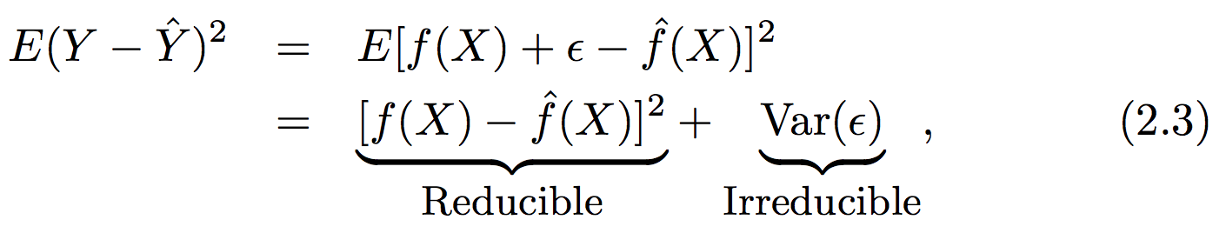
Some concepts about supervised learning (basic terminology)
In supervised learning we assume there is a functional form that can describe our output vector (Y) given some input vector (X)
We are concerned with estimating a function that can predict an output given a certain set of inputs
There are two limits to the error in our function
“E()” is the expectation value or average squared error
Notes:
Eps is random error

Slide 6
Some concepts about supervised learning (functional form)
Some models have a defined functional form over the entire range of input values (parametric modeling)
We assume a functional form (parameters or coefficients)
We determine the parameters by minimizing the error between the model and reality for some subset of our data (fitting or training)
Some models do not assume a defined functional form – the goal is just to get as close as possible to the data (non-parametric modeling)
There is still a model fitting procedure; the model still has some information content that is determined from your data
In parametric modeling you risk overfitting especially with noisy data. In non-parametric models you require much larger training data sets

Slide 7
Some concepts about supervised learning (I/O type )
In supervised learning, some models deal with the prediction of a numerical output given some inputs: regression problems
See if you can come up w/an example of where regression would be useful in materials / energy science
On the other hand, some models deal with the prediction of whether some object (defined by X) is a member of a certain group (or class): classification problems
See if you can come up w/an example of where classification would be useful in a problem related to social science
Some methods (e.g., KNN) can be used for regression purposes and classification purposes! Weird!

Slide 8
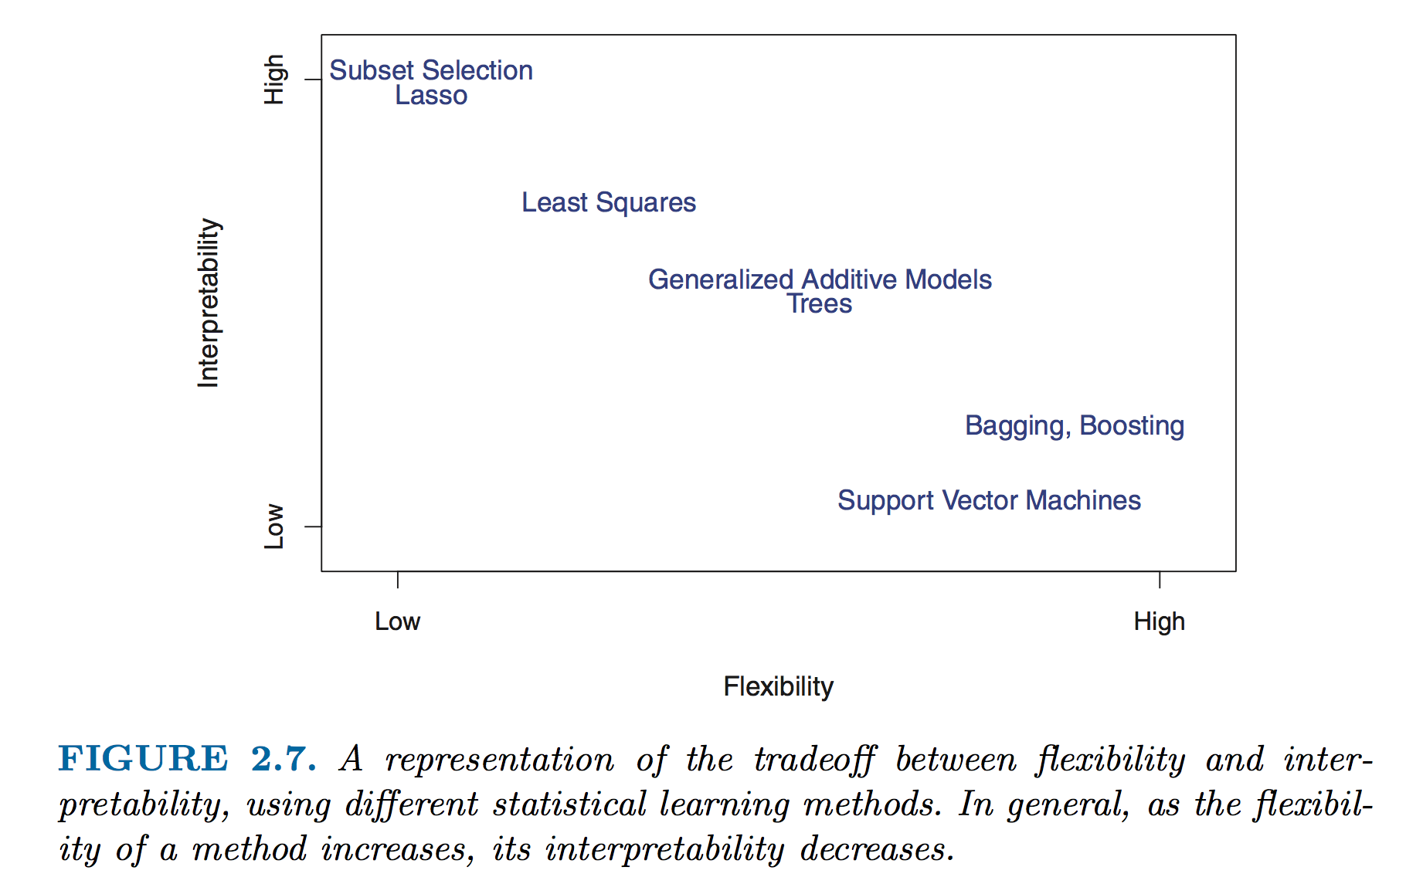
Basic Concepts about flexibility and interpretability

Slide 9
Data: Types of data and purpose
Supervised learning problems always require a set of data that must be used to train your model
Remember: model training means we are finding the minimum error between our predicted outputs and measured outputs (Ŷ vs Y)
We always want to know how our model is doing “out in the real world” on some data that the training process was blind to (validation)
Do unsupervised learning models need training and validation sets?

Slide 10
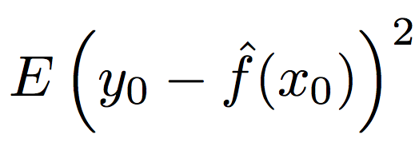
Assessment: Measuring model accuracy (regression)
The MSE as an estimator
Challenges with the MSE and why we need other estimators
Side conversation: Why is it squared error?
Does anyone know why we can’t use the MSE in classification problems?

Slide 11
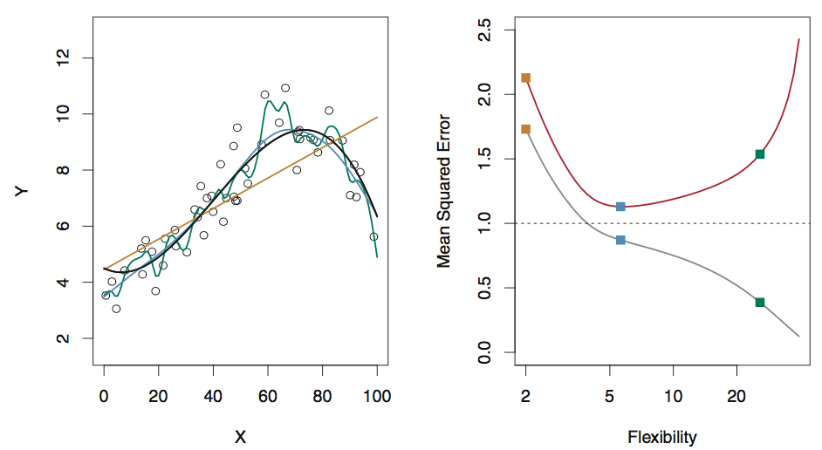
Assessment: Comparing models in linear regression
The true functional form is given w/the black curve
Compare errors in the training data from three test functions (orange, green, blue) [grey curve, right]
Compare errors in the testing data from the three test functions [red curve, right]
Fig 2.9, ISL

Slide 12
Assessment: Bias and variance
Ultimately we care about the true expectation value of the error of our model (given infinite testing data)
The variance in the error shows us how much the error changes if we estimated f with a different set of training data (e.g., consider fit w/many splines)
The bias in the error shows us how much error is introduced by the simplicity of our model (e.g., curvy data w/linear fit)
The total MSE can never fall below the variance in our observations! (irreducible error)

Slide 13
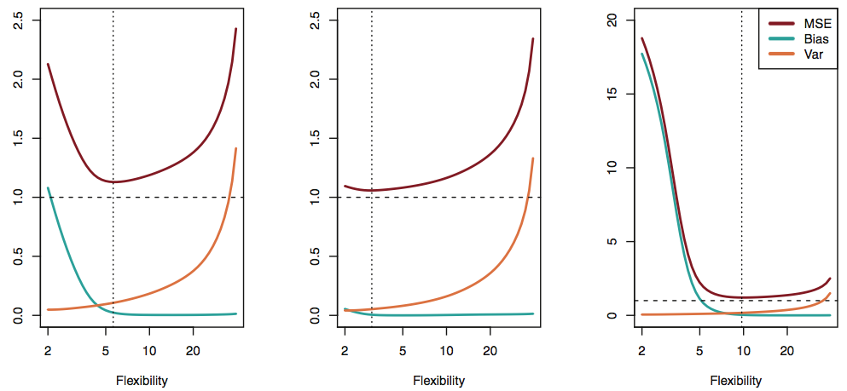
Bias and variance: the tradeoff
In practice, the bias error is difficult to estimate quantitatively, but the principle is critical to qualitatively understand!
See figs 2.9-2.11 and full version of Fig 2.12 in ISL for more examples!
Modified Fig 2.12, ISL

Slide 14
Assessment: Errors in classification problems
Even though we aren’t making a quantitative prediction, we still need to assess the model accuracy
Consider the frequency of incorrect classification, the error rate
The training error rate is the frequency of errors on our training data
Generally more interested in the test error rate, errors on data that were not used to train our classifier

Slide 15
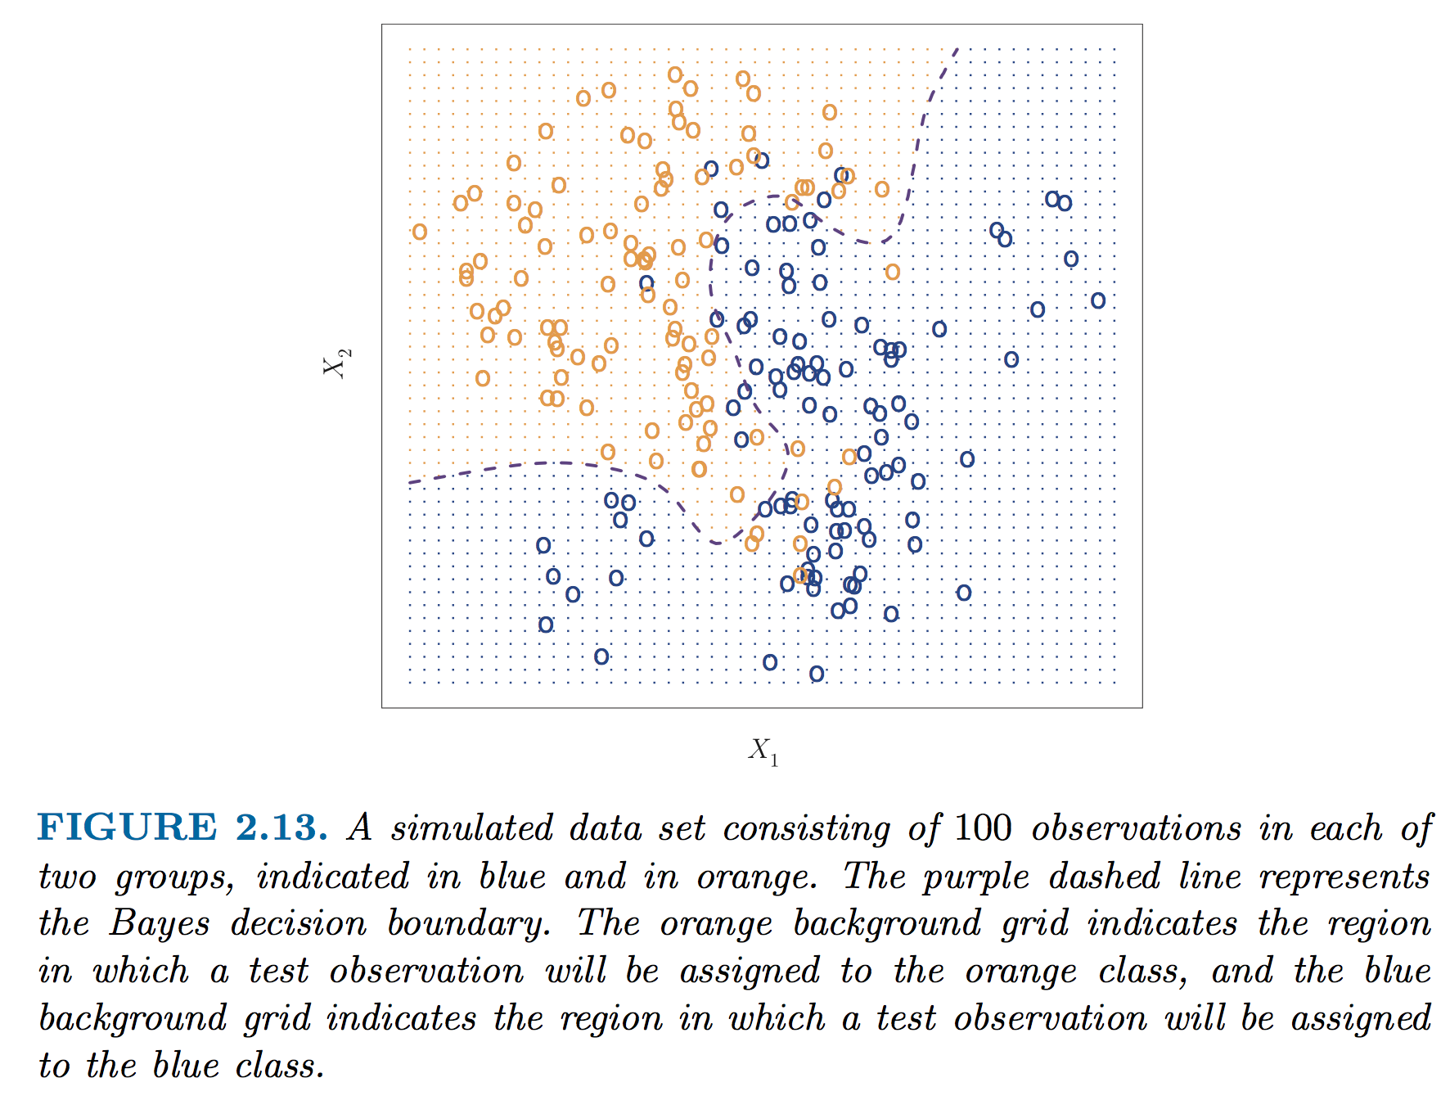
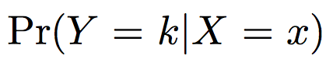
An estimator for the irreducible error in classification: Bayes classifier
My first classifier!
In principle if we know the true conditional probability distribution for our data, we can construct a surface (a decision boundary) that guarantees our error rate in classification is minimized
This ideal model is the “Bayes classifier” and this boundary is the “Bayes decision boundary”
Brief discussion of decision boundaries, visualization of classification models, and a warning about dimensionality!

Slide 16
Transition from ML overview!
Any questions / concerns
If people are really bored, someone could ask me to tell a joke right now

Slide 17
Classification methods
[quick warmup?] Examples of classification problems in materials or molecular science?
We will cover two types of classification methods in this class:
k Nearest Neighbors (often KNN)
Making a map of parameter space and estimating the class membership based on locality to other members of the class
Logistic regression
Making a mathematic guess about the likelihood of class membership using a simplified mathematical model (the logistic function)

Slide 18
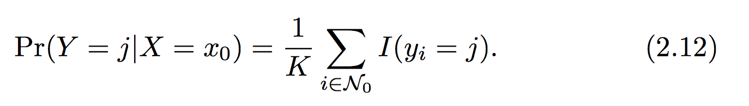
(probably) the simplest classification method is k-nearest neighbors (KNN)
The KNN classifier works on assigning the probability of membership in a class based on distance to other members in a class
Simple, right?
Our selection is based only on K – the number of neighbors we consider
What are the possible ranges of K?
The KNN classifier

Slide 19
A note about distances and identifying who is “nearest” ?
In this example, and all others we looked at and discussed you all made a key assumption (without realizing it) when you were identifying neighbors
The data in each dimension of X should be scaled similarly!
We are concerned with relative distances in the parameter space, not absolute distances in the underlying units
Otherwise units, dimensionality, etc. can drastically favor closeness in arbitrary dimensions of X

Slide 20
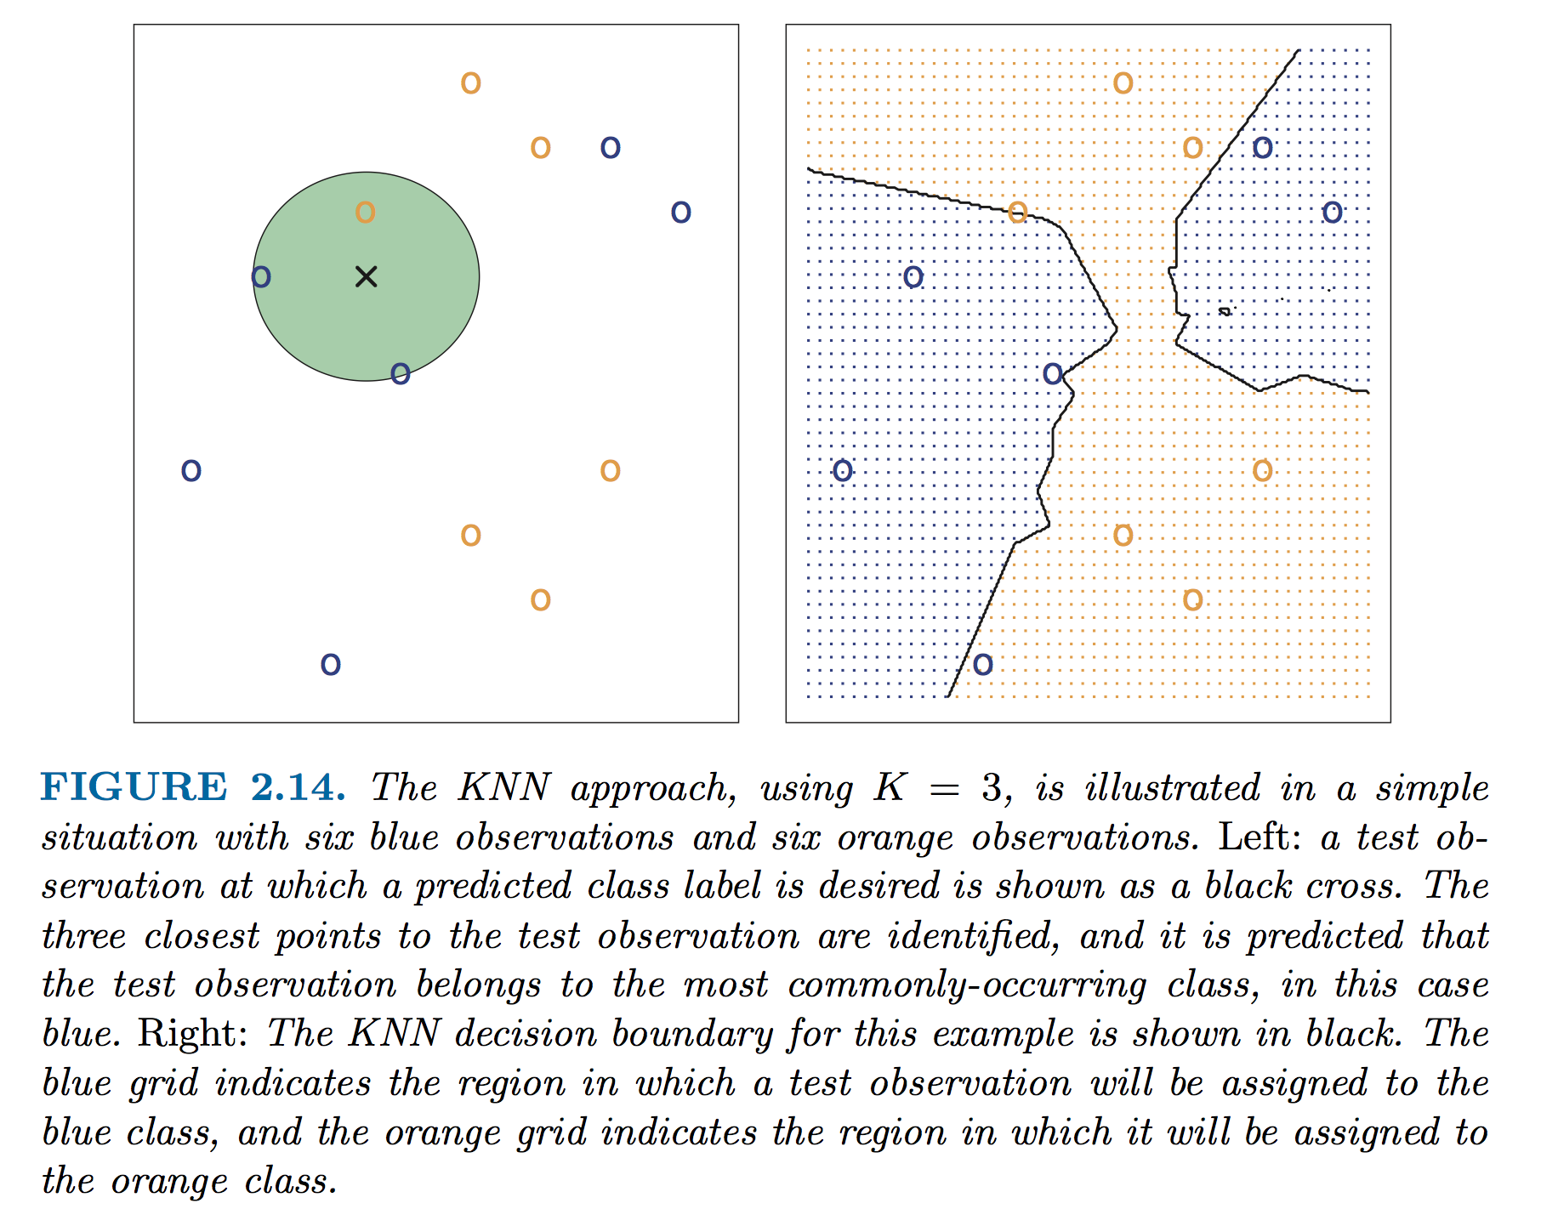
Illustration of KNN

Slide 21
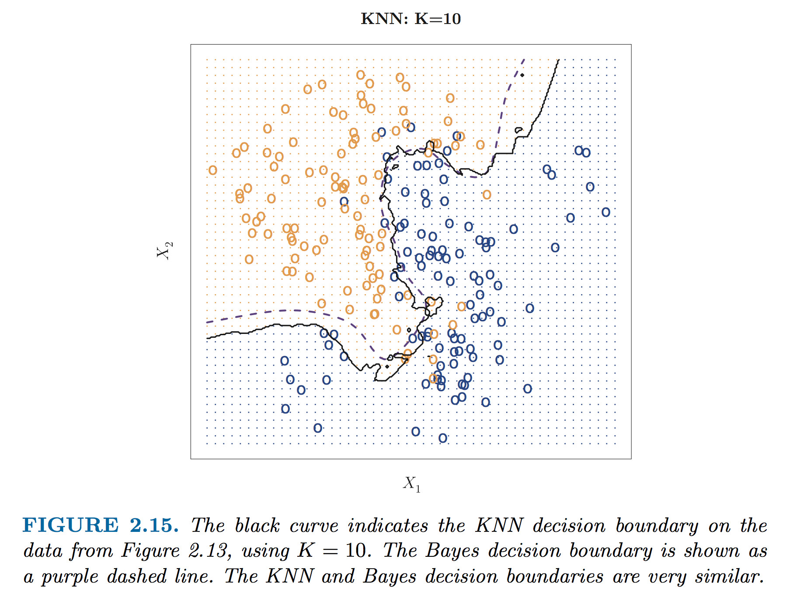
Effect of K on boundary

Slide 22
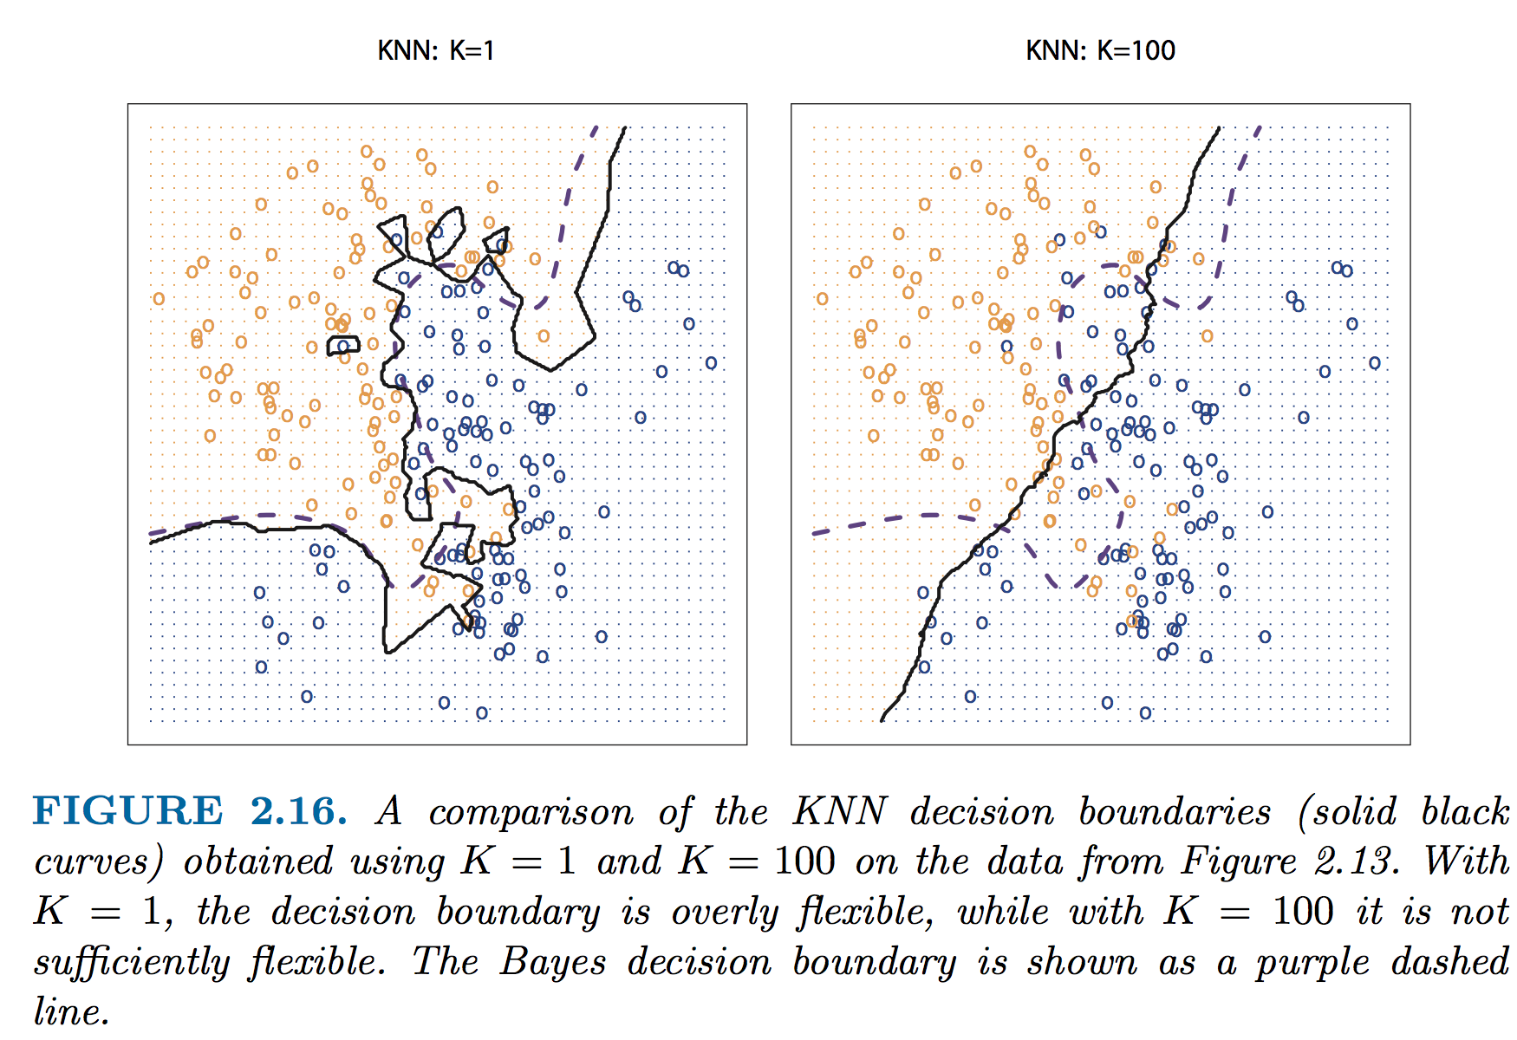
K too big or too small: noise and accuracy
Notes:
Why does this matter? Look @ islands w/K=1 and effect of noise! – look @ loss of flexibility w/ K=100 and loss of accuracy

Slide 23
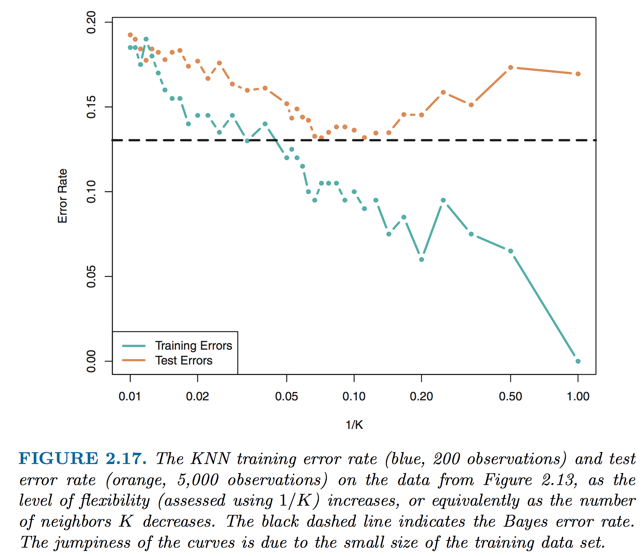
Effect of K on accuracy

Slide 24
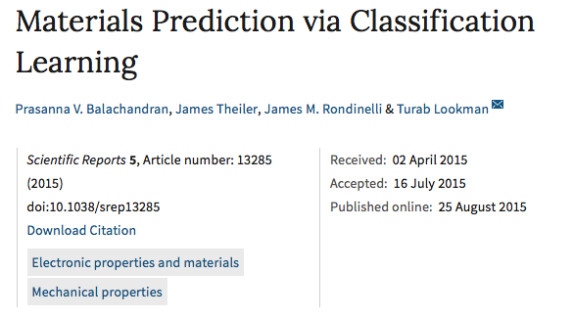
Practice with the KNN!
Lets get our hands dirty
The example data we are using come from the paper below
Much of the code comes from the scikit-learn KNN tutorial (http://scikit-learn.org/stable/tutorial/statistical_inference/supervised_learning.html)

Slide 25
With one partner (14x2!)
Get the W5L1.zip from #dsmcer and load it on one computer – it contains two data files and a python notebook
Open the notebook
Follow the instructions
OK?

Slide 26
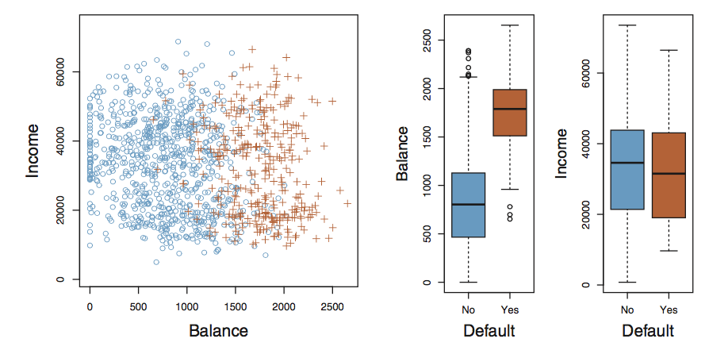
Classification with the logistic model
Key concepts
Consider the data below (ISL Fig 4.1), we are trying to make a guess as to whether someone will default on a loan on the basis of their bank account balance and income level
Questions?

Slide 27
Classification with the logistic model
As we said in class (Mon 2/1), performing regression on discrete classes is arbitrary (what are the outputs we assign to Yes/No and why?)
One caveat is the binary (two level response). Here we can always use a 0/1 coding!
Lets look at simple regression on this data

Slide 28
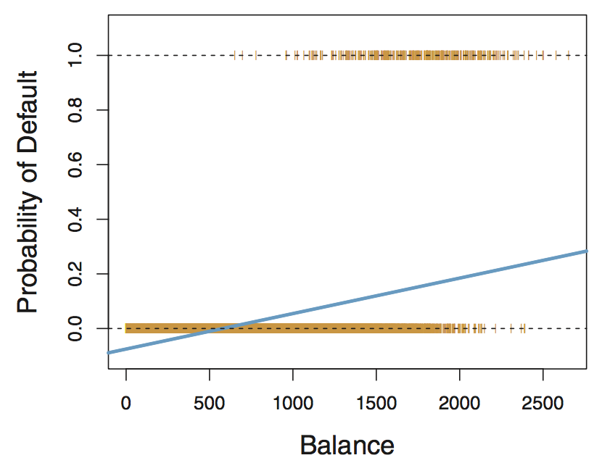
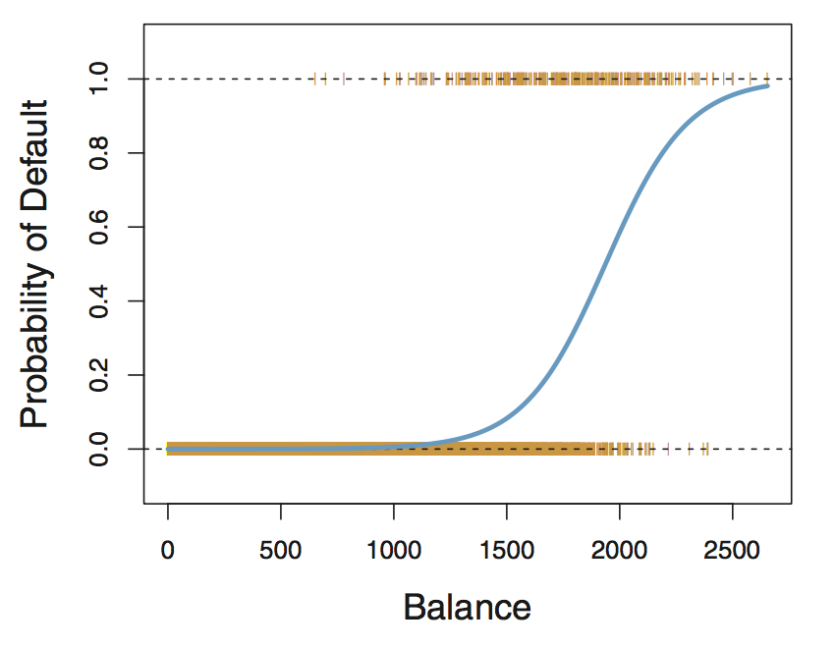
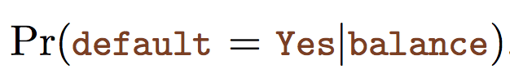
Classification with the logistic model
Fig 4.2 (left) shows us the outcome of simple linear regression using a 0/1 coding for the probability of default (0.0 or 1.0)
What does the model predict for Balance < $500?
Fig 4.2 (right) shows us the outcome of regression using a different functional form to describe situation where our variables are bounded between 0 and 1
This is modeled using the logistic function, which lets us sensibly answer this question: “what is the probability of default given some balance?”

Slide 29
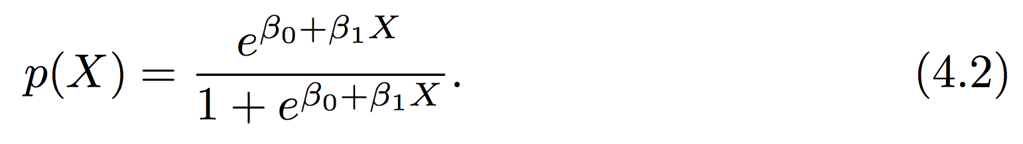
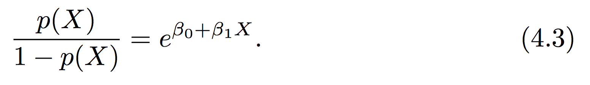
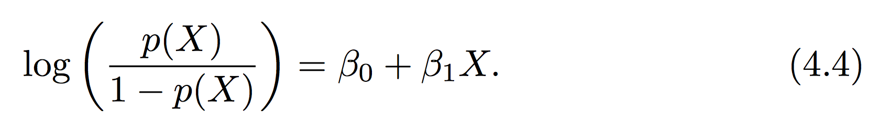
The logistic function
The logistic equation (4.2) provides a smooth transition between 0 and 1
Compare simple linear model and logistic eq
In terms of the “odds”
Can anyone define “odds”? If your probability of success is 1 in 5 (0.2) , your odds of success are 1 in 4: 0.2 / (1-.2) = .25
Log of the odds is the “logit”, relates the change in log of odds of success w/change in X

Slide 30
Is the logistic model a classifier?
Yes!
Given a class situation “e.g., default vs. non-default”, the logistic model can take a set of training data and give a function that makes a prediction about what class a new or different input would be in
P < 0.5 = no default vs. P >= 0.5 default
We can also use a binary response (e.g., 0 vs 1) and train a multiple logistic model (e.g., many X_{i})
We could also use multinomial logistic models to describe a situation with >2 classes

Slide 31
Basic concept of logistic regression
(much more next two weeks on regression!)
For reasons we won’t discuss in detail standard regression models don’t work well on the logistic equation.
But we still need to determine our coefficients: β_{i}
This is done through a procedure called maximum likelihood estimation
The basic idea is that we seek to find the set of β_{i} that maximizes the probability of making the correct prediction

Slide 32
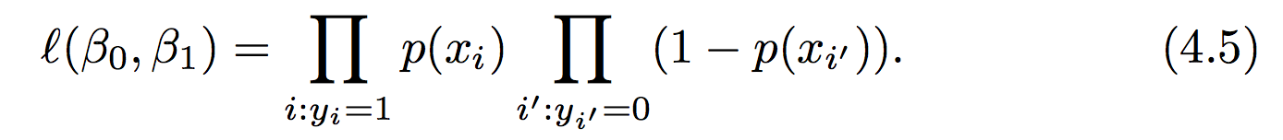
Simple illustration of MLE
The likelihood function can be defined in terms of the product of all the probabilities
In the case of the binary (0 vs 1) scenario:
Recall each probability is defined by our logistic eq:
We seek the values of β_{i} that maximize 4.5

Slide 33
Example and implementation in Python
We saw on Monday that there is a python library “sklearn” (sci-kit learn), that can be used to perform machine learning techniques
Monday example: KNN
We will use many other ML methods from sklearn this quarter
Sometimes practice in class, sometimes practice on HW, sometimes example in class notes

Slide 34
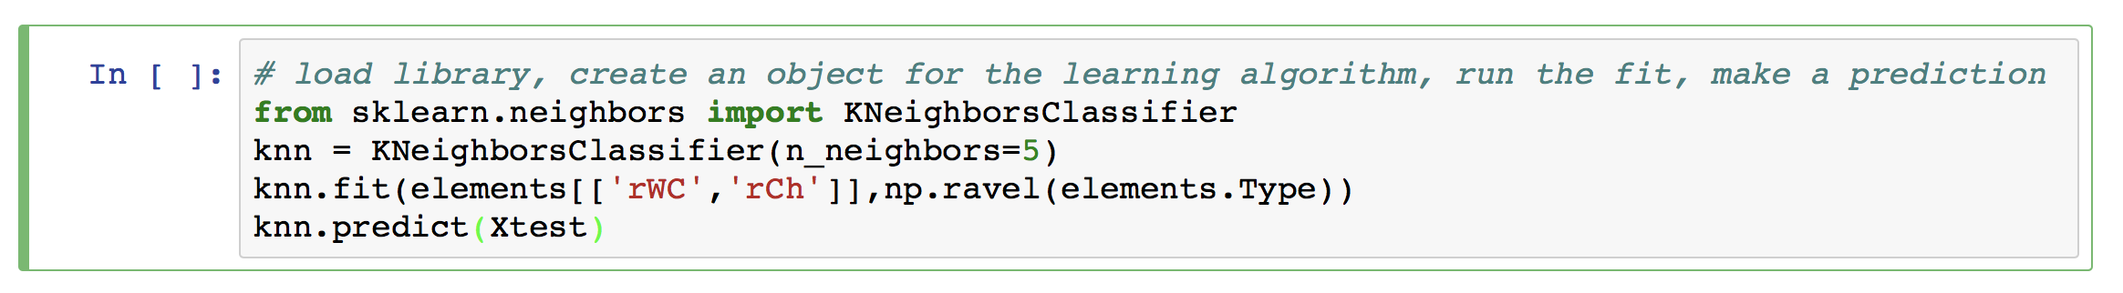
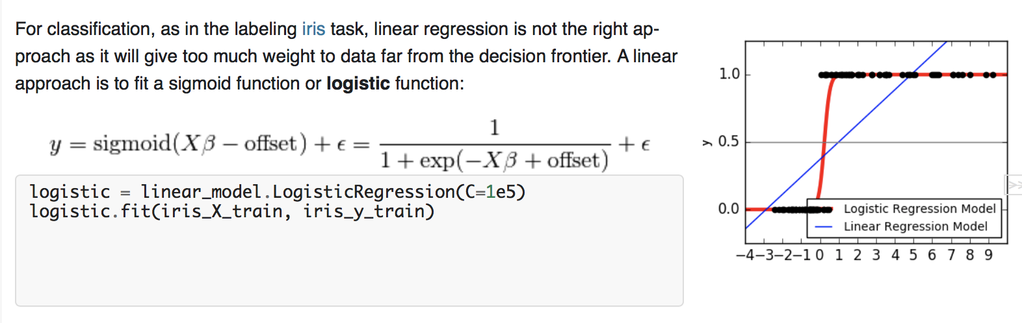
Example and implementation in Python
Recall key elements of our KNN model using sklearn:
Logistic regression is similar:
From sklearn tutorial

Slide 35
A quick lit review of an interesting ML paper

Slide 36
Statistics and Machine Learning
A recent example of ML applied to materials property prediction
Highlights from Abstract (10,000 foot view)
Kernel regression is used as a rigorous and nonparametric statistical technique to predict properties of atomic crystals
The property prediction approach is illustrated by training models to predict electronic properties of 746 binary metal oxides and elastic properties of 1173 crystals
As a first approach to solving the inverse problem, an exhaustive enumeration algorithm is described
From Wikipedia: Non-parametric models differ from parametric models in that the model structure is not specified a priori but is instead determined from data. The term non-parametric is not meant to imply that such models completely lack parameters but that the number and nature of the parameters are flexible and not fixed in advance.

Slide 37
Result/Concept: Parsing out your data
This paper drew data from the Materials Project using their API.
The data are calculated using DFT [ any questions/concerns? ]
In a regression or ML model data need to be divided into training and validation sets
Basic principles: if you don’t save some of your data how can you ever quantitatively evaluate whether your model is predictive?
Sometimes training is broken into an additional piece (testing → more later)
Sometimes multiple rounds of training and validation are used (more later)
Notes:
asdasdfasdf

Slide 38
Result/Concept: Types of methods and assessment
This paper uses a machine learning model called kernel ridge regression. Much more later. The basic idea is a regression technique
The predictors that are used to fit the model include:
The 3D crystallographic space group of the material
Example: “P21/c, centrosymmetric“ How is this coded into a variable?
Number of atoms of each element in chemical formula
Notes:
There are 230 space groups ! 1-230

Slide 39
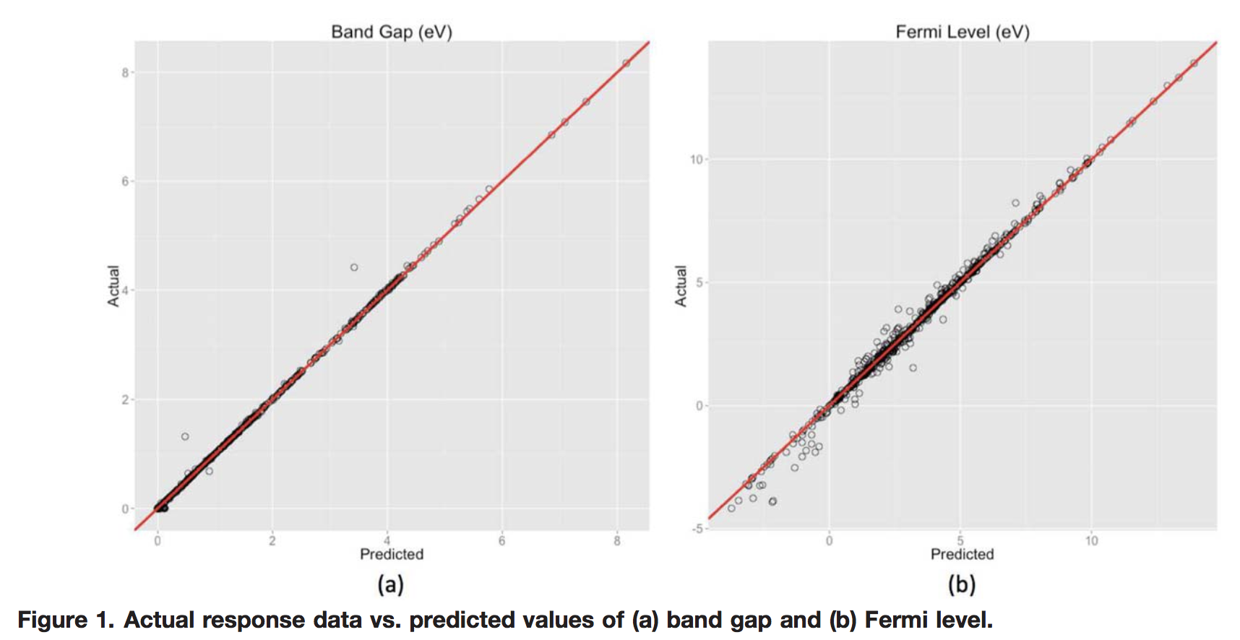
Result/Concept: Validation (electronic properties)
Notes:
asdasdfasdf

Slide 40
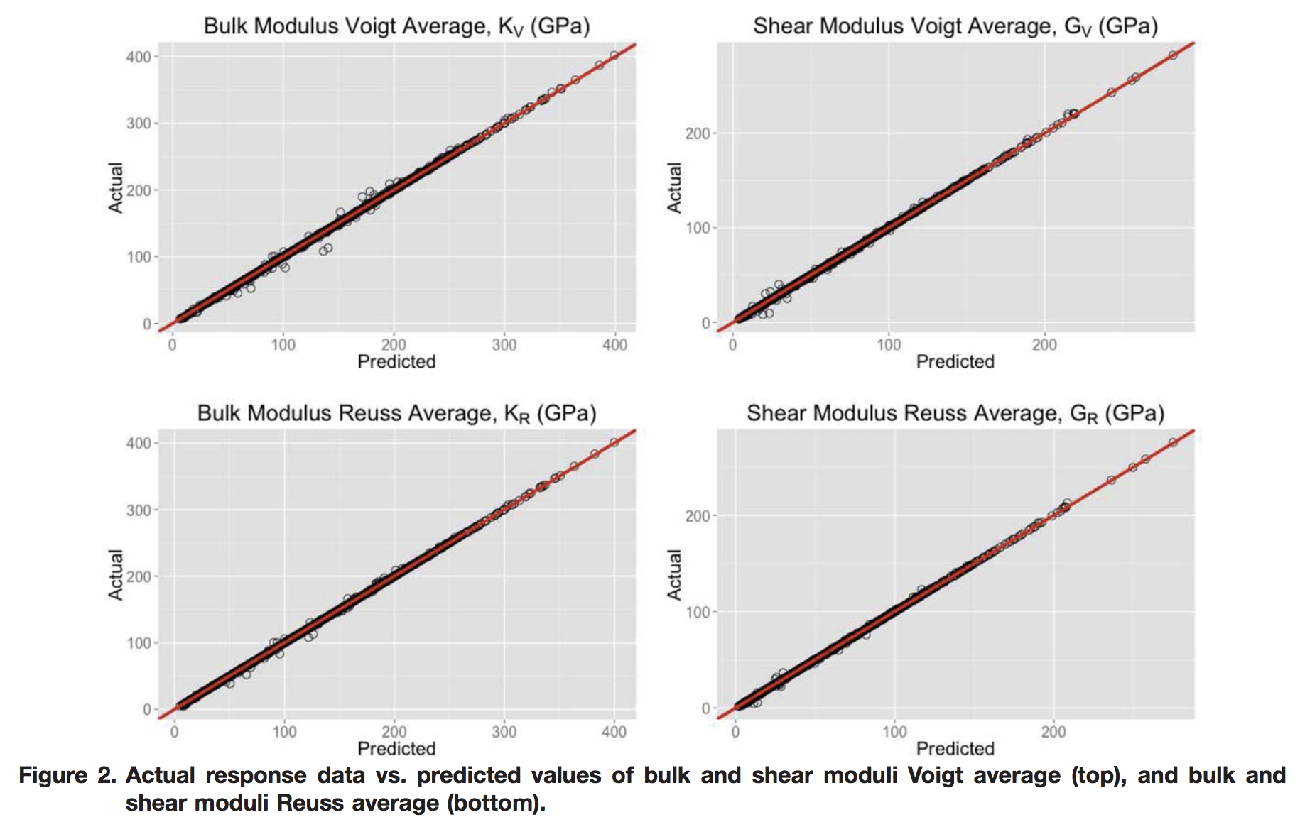
Result/Concept: Validation (elastic properties)
Notes:
asdasdfasdf

Slide 41
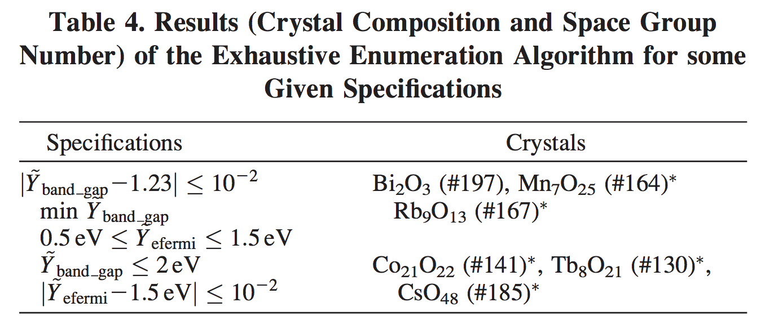
Result/Concept: Application
The ML algorithm the authors chose permits a process called “exhaustive enumeration” (just like it sounds) on a reasonable time scale
The authors used this property to carry out something called inverse design
Why does this matter in materials / chemicals science?
Notes:
asdasdfasdf

Slide 42
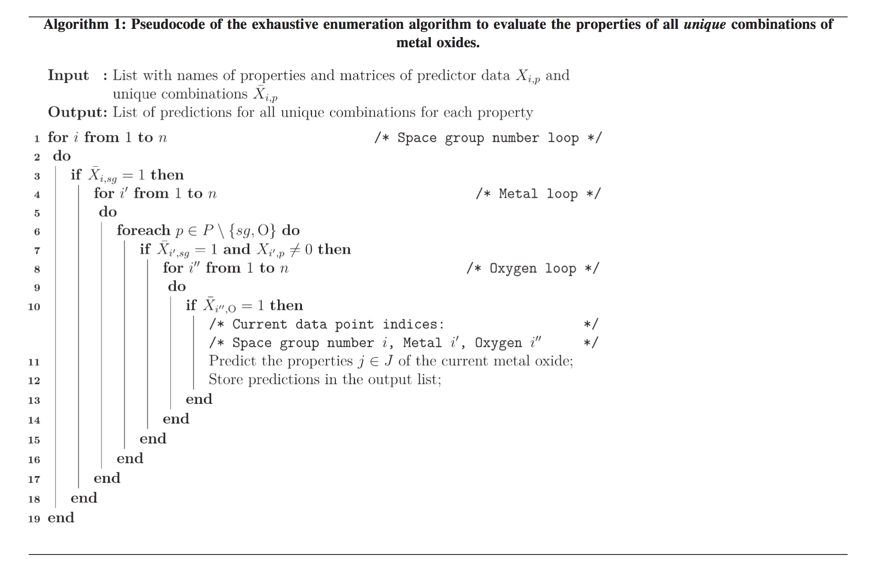
Result/Concept: Reproducibility
Also see the outstanding SI of this paper

